Slide 1
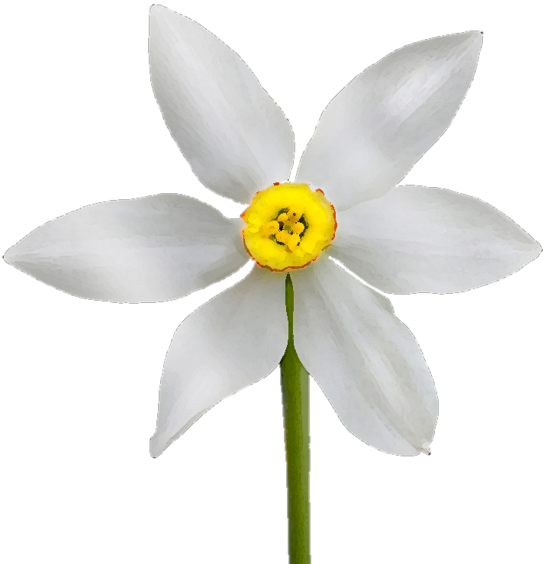
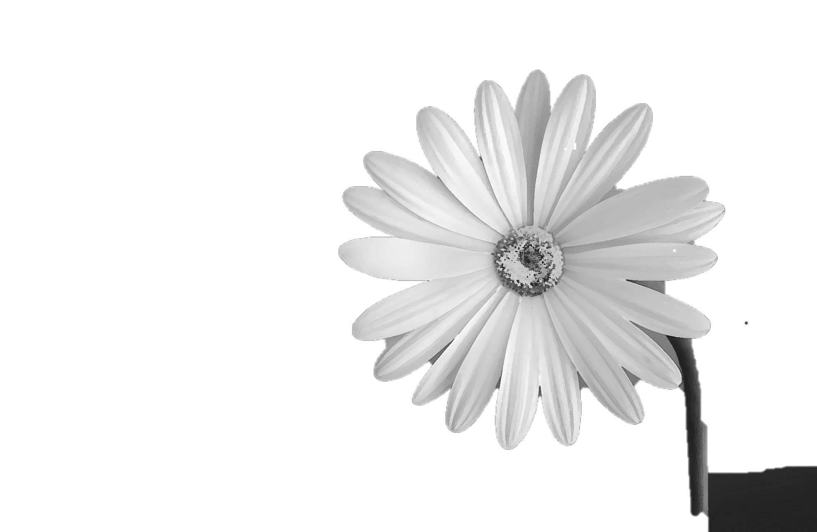


heterospecific pollen deposition
stigmas clogged by other species pollen

Slide 2

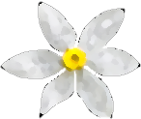
conspecific pollen transfer
pollen lost to other species

